Slide 1

PIVOT
Probability-Guided Synthesis of Network Updates via Transient Intermediate States
Xiaowen Wang, Haifeng Sun
Beijing University of Posts and Telecommunications
The 10th Asia-Pacific Workshop on Networking, 2026
APNet '26
Notes:
Good morning. I am Xiaowen Wang from Beijing University of Posts and Telecommunications. Today I will present PIVOT, a probability-guided planner for safe network configuration updates. The main idea is to synthesize a sequence of transient intermediate states. This is important because a production network cannot simply jump from the old configuration to the target configuration. During the update, the network is still carrying traffic, so every intermediate state must also satisfy the safety constraints. PIVOT searches for useful temporary steps, and a formal verifier checks each step before it is committed.

Slide 2
Safe updates can need temporary detours
A safe plan may need a helper action outside the final target diff.
Two update regimes
97.5%
Direct-Reordering: order the target edits.
Snowcap on Direct-Reordering
Detour-Requiring: add and later remove helper actions.
Helper actions are invisible in the final target diff.
0%
Snowcap on Detour-Requiring
PIVOT solves 34.1% of detour-requiring cases.
2
Notes:
To motivate the problem, network updates can be divided into two regimes. In Direct-Reordering, a safe plan can be obtained by ordering the target edits. In Detour-Requiring, this is not enough. The plan must add a helper action and later remove it. The important difficulty is that this helper action is invisible in the final target diff. Therefore, a search space that only contains target edits can miss the safe path. PIVOT is designed for this second regime. In our benchmark, it solves 34.1 percent of detour-requiring cases by proposing temporary helper steps. As a reference point, Snowcap solves 0 percent in this regime.

Slide 3
Existing approaches can miss transient states
The bottleneck is discovering the right intermediate transition.
Search-based synthesis
Reordering methods
Strong safety guarantees
Shrink the search space
Large candidate execution space
Assume target edits are enough
Pruning can miss narrow feasible regions
Miss helper actions absent from the final diff
Needed: propose flexible intermediate moves, then verify every step.
3
Notes:
Before introducing PIVOT, it is useful to clarify the limitation of existing approaches. Prior work has made strong progress on safe network updates, especially on verification and synthesis. However, many methods work best when the correct plan can be built directly from the target edits. Search-based synthesis can provide strong safety guarantees, but it still needs to explore a large space of candidate executions. Under limited time budgets, aggressive pruning may miss a narrow feasible region. Reordering-based methods reduce the search space, but they are fundamentally limited when the safe transition needs temporary helper actions. This motivates a planner that can propose flexible intermediate moves, while still verifying every committed step.

Slide 4
The missing intermediate move is a temporary bridge
Missing move
Initial relay: node 0
Target relay: node 4
Safety: nodes 1 and 2 stay reachable
First safe action: +0->4
The transient bridge creates the safe path.
4
Notes:
The previous slide said that existing methods can miss important intermediate transitions. This BGP example shows exactly what such a transition looks like. Node 3 is the route source, and nodes 1 and 2 must stay reachable after every converged update step. Initially, node 0 relays the route. In the target state, node 4 should relay the route. A direct switch can break reachability, because node 4 is not ready to serve the clients yet. The missing move is to add a temporary bridge from node 0 to node 4. After this bridge is installed, node 4 can serve nodes 1 and 2. Then the ingress can switch, and the old sessions can be removed. This transient bridge is the key intermediate state that creates the safe path.

Slide 5
PIVOT plans one safe step at a time
LLM sampling proposes diverse next actions; formal verification keeps safety.
1
2
3
Predict
->
Verify
->
Search
Sample candidate edits with an LLM.
Check applicability and safety for each candidate.
Keep several verified-safe prefixes in a beam.
Safety stays with the verifier.
Probability guides exploration; verification decides safety.
5
Notes:
Based on this observation, PIVOT plans one safe step at a time. The method has three parts. First, an LLM-based predictor samples candidate edits from the current state. This is the probability-guided part: the model distribution gives structured diversity, so both common target edits and plausible helper edits can appear in the candidate set. Second, a verifier checks applicability and safety for each candidate. Third, beam search keeps several verified-safe prefixes. In this design, probability guides exploration, and safety stays with the verifier.

Slide 6
The LLM predictor samples abstract edits
Input context
Output grammar
T: topology
insert one entry
C_init: initial configuration
remove one entry
C_tgt: target configuration
change one entry
Cons: safety constraints
DONE
P: committed prefix
Probability-guided: sample several actions, then verify them.
6
Notes:
The predictor is a fine-tuned LLM, and it predicts only one abstract edit at a time. Its input contains the topology, the initial configuration, the target configuration, the safety constraints, and the committed prefix. This input tells the model where the update starts, where it should end, what must remain safe, and what has already been done. The output follows a small grammar: one action, or it has been DONE. At inference time, PIVOT samples several actions from the LLM distribution. These sampled actions then go to the verifier, so the model can broaden the search without weakening correctness.

Slide 7
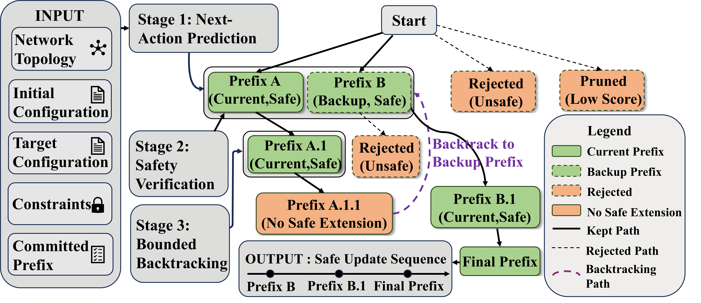
The verifier filters actions; the beam keeps backups
Verifier checks
Can this action apply?
Is the next state safe?
If yes, add it to the beam.
Beam search gives bounded backtracking.
7
Notes:
After prediction, the verifier acts as the safety gate. A proposed action is not committed immediately. It must first pass two checks. The first check is applicability: can this action be applied to the current configuration? The second check is safety: does the next state satisfy the constraints? Only actions that pass these checks enter the beam. The beam keeps several verified-safe prefixes instead of only one prefix. This is useful because a locally safe action may still lead to a dead end later. With beam search, PIVOT has bounded backtracking and can recover from such choices.

Slide 8
PIVOT adds value in detour-requiring updates
41 / 120
Safe detour plans found by PIVOT
34.1%
Success on detour-requiring cases
PIVOT helps when safe plans need helper actions.
8
Notes:
The main result is organized by update regime. The full comparison includes both Direct-Reordering and Detour-Requiring cases, and the key regime for PIVOT is Detour-Requiring. In these cases, the safe plan needs helper actions outside the final target diff. PIVOT finds 41 safe plans out of 120 cases, which corresponds to 34.1 percent success. This result supports the main claim of the method: when safe updates need temporary helper actions, probability-guided proposals can give the verifier useful detour steps to check.

Slide 9
Short updates can still need hidden steps
49 valid cases, average update length below 30 steps.
55.1%
91.8%
+36.7 pts
Snowcap success
PIVOT success
Absolute gain
Length is not the only source of difficulty.
9
Notes:
A natural question is whether detour cases are hard only because the plans are long. To answer this, we evaluate 49 valid cases whose average update length is below 30 steps. Snowcap solves 55.1 percent of these cases, while PIVOT solves 91.8 percent. The absolute gain is 36.7 percentage points. This shows that length is not the only source of difficulty. Even a short update can require a hidden temporary state. PIVOT helps because it searches for useful next steps, rather than only sorting the final target edits.

Slide 10
Detour success tracks search-space size
Scale view
Small: 59-70%
Medium: 34-38%
Large: about 8%
The same mechanism is evaluated across three scale metrics.
10
Notes:
We also analyze detour-requiring cases under three scale metrics: target edit count, affected-node count, and topology size. Across these metrics, PIVOT has the highest success on small cases, around 59 to 70 percent. It also keeps measurable success on medium cases, around 34 to 38 percent. This gives a more detailed view of where the current search budget is most effective. More importantly, the same predictor-verifier-search mechanism is evaluated across different definitions of scale, so the analysis is consistent with the design of PIVOT.

Slide 11
Beam search is central to PIVOT
18.0% -> 59.9%
Beam 1 to beam 4
Why it helps
A safe next step can still lead to a dead end. Backup prefixes give recovery points.
11
Notes:
Finally, the ablation study explains why beam search is central to PIVOT. With beam width 1, the planner is greedy, and the success rate is 18.0 percent. Increasing the beam width to 4 raises success to 59.9 percent. Wider beams continue to improve the result, reaching 83.3 percent with beam 10 and 91.6 percent with beam 20. The reason is that safety at the current step is not enough to guarantee a good full plan. Some safe prefixes may later stop making progress. Keeping backup safe prefixes gives the planner recovery points.

Slide 12
Q&A
Notes:
To conclude, PIVOT separates exploration from safety. The LLM predictor samples possible next actions from a learned probability distribution. The verifier checks whether each action is safe. The beam keeps backup safe prefixes. Together, these parts help safe update planning discover temporary detours. The key message is simple: probability guides exploration, and verification keeps the plan safe. Thank you for listening. I am happy to take questions.

